Slide 1
Promotion and Tenure Committee Workshop
SEPTEMBER 21, 2023

Slide 2
AGENDA
Introductions
P&T perceptions and outcomes
P&T process and policies
Department heads’ perspectives
Dean’s perspective
University P&T Committee’s perspective
Questions and discussion

Slide 3
P&T Perceptions AND Outcomes
Ron fricker, vice provost for faculty affairs

Slide 4
CLARITY OF TENURE PROCESS
FROM 2023 COACHE FACULTY JOB SATISFACTION SURVEY

Slide 5
CLARITY OF TENURE STANDARDS
FROM 2023 COACHE FACULTY JOB SATISFACTION SURVEY

Slide 6
PROMOTION AND TENURE SUCCESS 2013-2023

Slide 7
P&T PROCESSES AND PRACTICES
Ron fricker, vice provost for faculty affairs

Slide 8
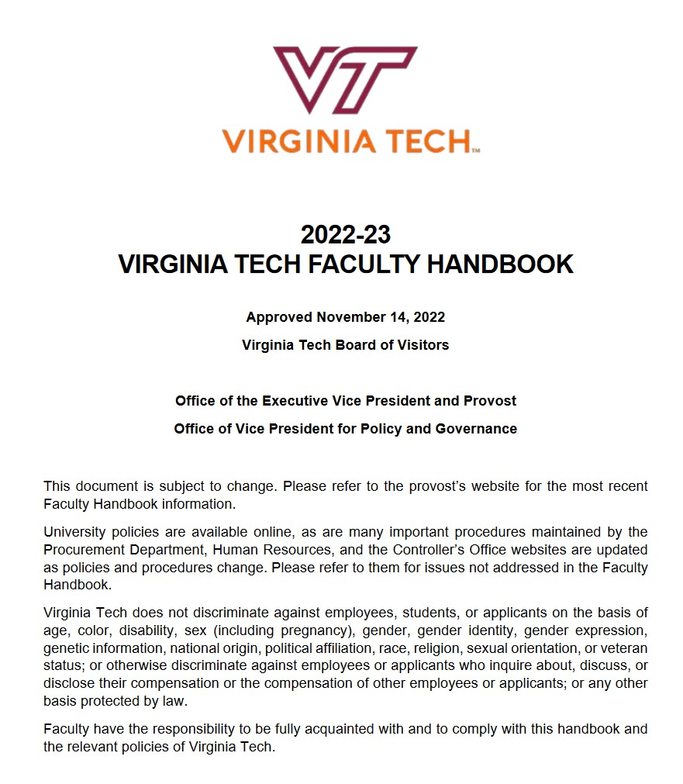
P&T Governed by Faculty Handbook
Section 3.4 in particular:
3.4 Promotion and Tenure
3.4.1 Tenure Eligibility
3.4.2 Pre-Tenure Probationary Period and Reviews of Progress Toward
Promotion and/or Tenure
3.4.2.1 Extending the Tenure Clock
3.4.3 Guidelines for the Calculation of Prior Service
3.4.4 General Expectations for Promotion and Tenure
3.4.4.1 Departmental Evaluation for Promotion and Tenure
3.4.4.2 College Evaluation for Promotion and Tenure
3.4.4.3 University Evaluation for Promotion and Tenure
3.4.5 Appeals of Decisions on Non-Reappointment, Tenure, or Promotion
3.4.5.1 Appeal of Probationary Non-Reappointment
3.4.5.2 Appeal of Promotion and/or Tenure Decision
See https://faculty.vt.edu/faculty-handbook.html

Slide 9
Important Info on Provost’s Website
Dossier template and preparation guidelines
University-level deadlines for promotion and tenure review
P&T Workshop dates
Historical summary of P&T outcomes
See https://faculty.vt.edu/promotion-tenure.html

Slide 10
PROMOTION AND TENURE PROCESS
Department Level
College Level
University Level
Dossier
P&T Comm
Head
P&T Comm
Dean
P&T Comm
Provost
External Letters
BOV
President

Slide 11
PROMOTION AND TENURE DOSSIER OUTLINE
I. Executive Summary
II. Recommendation Statements
III. Candidate’s Statement
IV. Teaching and Advising Effectiveness
V. Research and Creative Activities
VI. International & Professional Service and Other Outreach & Extension Activities
VII. University Service
VIII. Work Under Review or In Progress
IX. Other Pertinent Activities
See https://faculty.vt.edu/promotion-tenure.html

Slide 12
P&T POLICIES AND PRACTICES
POLICIES
2nd and 4th year progress reviews
Tenure clock extension(s)
Modified duties
Non-mandatory promotion to associate with tenure
See memo dated September 21, 2022
Progress toward promotion to professor
PRACTICES
Mentoring
P&T Workshops
P&T Committee and Heads
Promotion to Professor
College-based workshops
Written expectations and standards

Slide 13
CHANGES TO P&T PRACTICES
Select 2023-24 Faculty Handbook changes (see September 6, 2023 memo)
Use of departmental/college Expectation Documents
“Each department or school (or college, when college-wide guidelines are applied) is required to have “Expectations Guidelines for Promotion and/or Tenure. .... Expectations must be adhered to at every stage of the promotion and/or tenure process.”
Candidates must be notified at each stage in the process
“At each level of review in the process, the candidate must be notified of the result of the review, whether positive or negative. The department head, chair, or school director notifies the candidate of the result of the departmental review, and the dean notifies the candidate of the result of the college level review. Notifications will only indicate whether the candidate’s case moved on to the next level of review or not; they will not include the results of votes, the names of external evaluators, statements.”
Candidates may only be evaluated twice (“two-bites rule☺
“Faculty members may only be evaluated two times for promotion and tenure or continued appointment. The two evaluations may each be in a non-mandatory year, but in the case of a second non-mandatory negative decision, the faculty member will not be allowed a third evaluation. If the second evaluation results in a negative decision, a one-year terminal appointment is offered.”

Slide 14
CHANGES TO P&T DOSSIERS & Process
Select dossier changes (see May 3, 2023 memo):
Dosser certification form
Dossier coversheet changes
Dates of pre-tenure or progress towards professor reviews required
Percent assignment for teaching, research and service
Abstain voting category removed
Peer teaching evaluation guidance
A minimum of two pages each with substantive detail regarding the teaching
Represent different points of time and different classes and/or differing instructional events
Address topics such as course organization and management, pedagogical strategies, content knowledge and communication, assessment strategies, and student engagement, among others.
Select process reminders:
No dossier revision after submission
Use department head or dean’s letter to communicate new additional information
If tenure clock extension, external letters must tell reviewers to use same standards
See memo dated April 3, 2023

Slide 15
P&T PERSPECTIVES
Department Heads
Dean
University P&T Committee

Slide 16
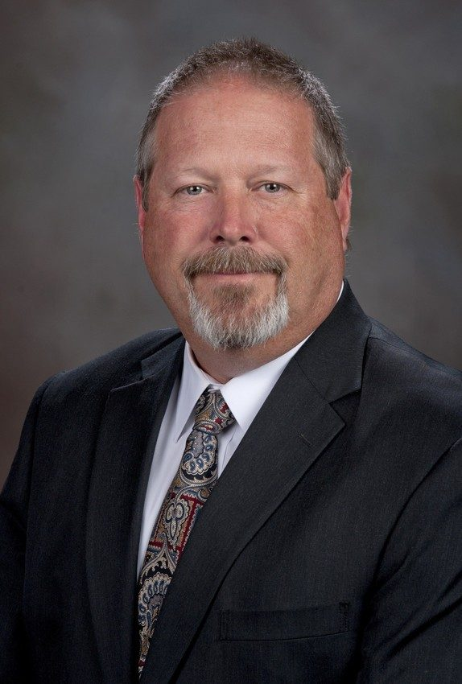
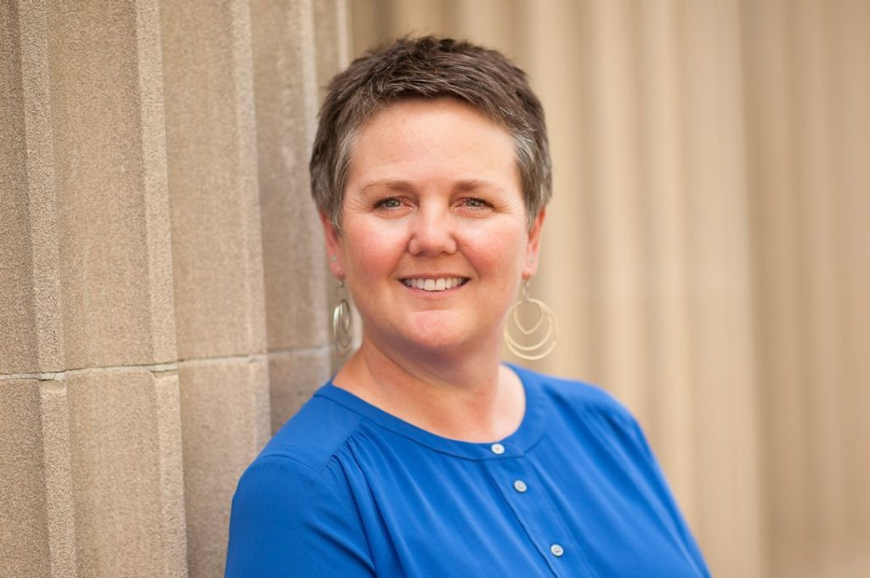
DEPARTMENT HEADS’ PERSPECTIVES
Jennifer Johnson
Sociology
Joel Snodgrass
Fish and Wildlife Conservation

Slide 17
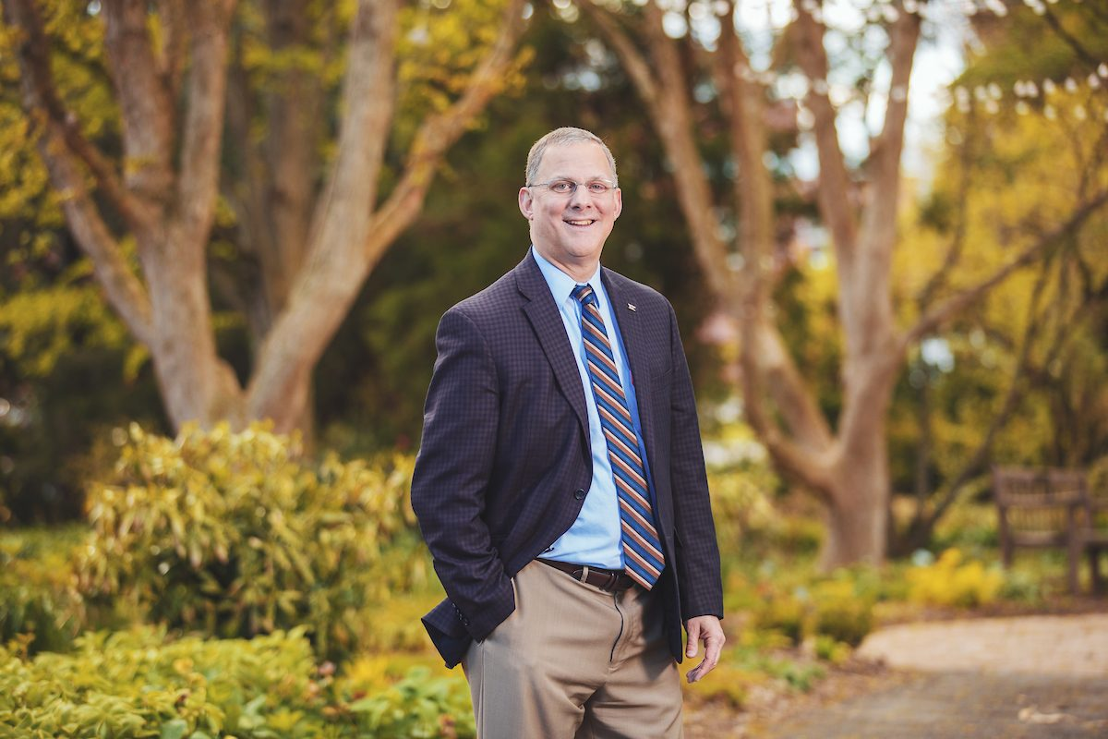
DEAN’S PERSPECTIVE
Alan Grant
Agriculture and Life Sciences

Slide 18
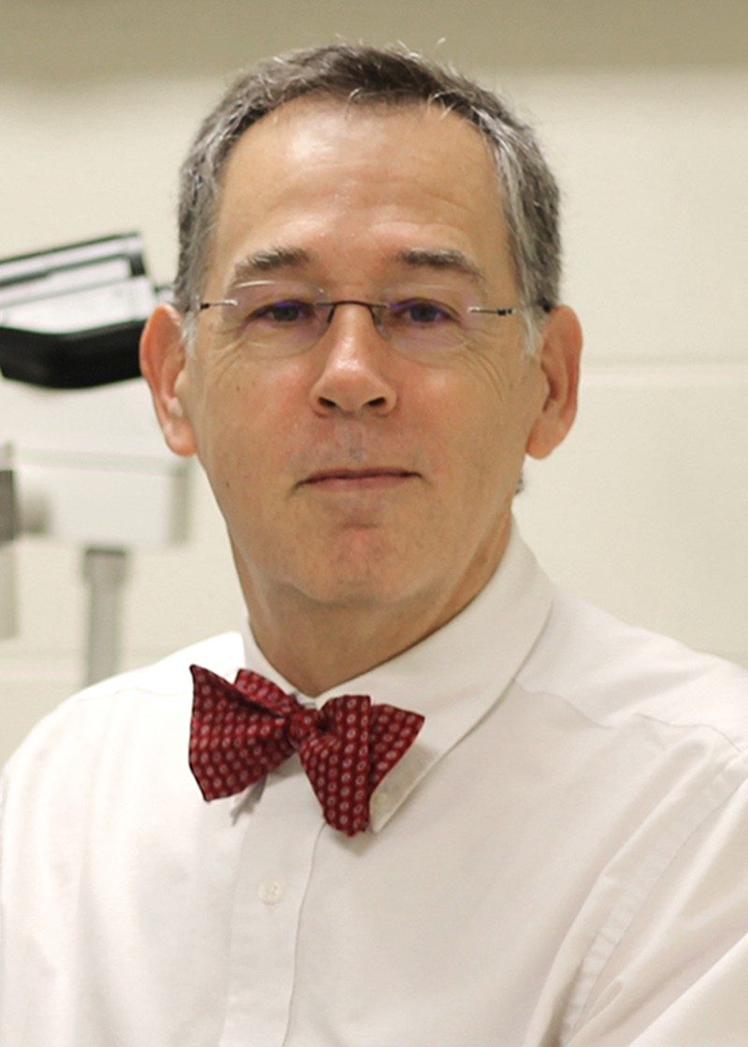
UNIVERSITY P&T COMMITTEE PERSPECTIVE
Kurt Zimmerman
Biomedical Sciences and Pathology

Slide 19
Questions and discussion
Visit the Promotion and Tenure website for more information:
https://faculty.vt.edu/promotion-tenure.html

Slide 20
OTHER RESOURCES

Slide 21
COVID-19 IMPACT CONSIDERATIONS
Faculty COVID statements
Inclusion of cancelled/postponed and/or virtual presentations
SPOT scores for calendar year 2020 optional
Tenure Clock Extensions
Work assignment adjustments
Modified duties
External letter reuse
See https://faculty.vt.edu/promotion-tenure/adaptations-promotion-tenure-process.html

Slide 22
COLLEGE P&T GUIDELINES
College of Agriculture and Life Sciences
College of Architecture, Arts, and Design
College of Engineering
College of Liberal Arts and Human Sciences
College of Natural Resources and the Environment
College of Science
Pamplin College of Business
Virginia-Maryland College of Veterinary Medicine
Virginia Tech Carilion School of Medicine

